Slide 1




Instrument Simulation and Flight Software Testing for Aspera SmallSat Telescope
Jacob Chambers
Mentor: Dr. Carlos Vargas, Steward Observatory
University of Arizona

Slide 2
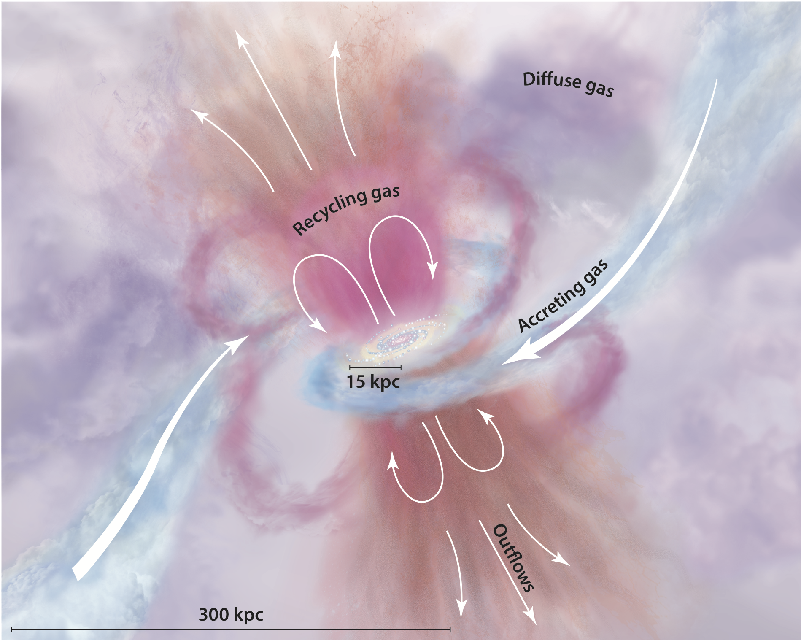
Aspera Mission Overview
Aspera is an ultraviolet (UV) small satellite mission designed to map O-VI emissions from nearby galaxies for the first time
The discoveries will help further understanding of the circumgalactic medium (CGM)
By the conclusion, we will have a better understanding of galaxies’ gaseous inflows and outflows
Source: Tumlinson, Peoples, and Werk, 2017

Slide 3
Project Objectives
Before launch, it is imperative to ensure that all software is operational and tested
Project was separated into two important pre-launch components:
1. Configure a framework to ensure flight software is tested automatically before deployment
2. Design and create a simulator to generate sample “events” seen by the telescope during observations to allow for development of the data reduction pipeline

Slide 4
Flight Software Testing Procedure
Choose testing frameworks for all software, written in both Python and C++
Develop a continuous integration/continuous development (CI/CD) pipeline to automate all tests in GitLab repository
Ensure that the test results can be viewed in a simple user interface

Slide 5
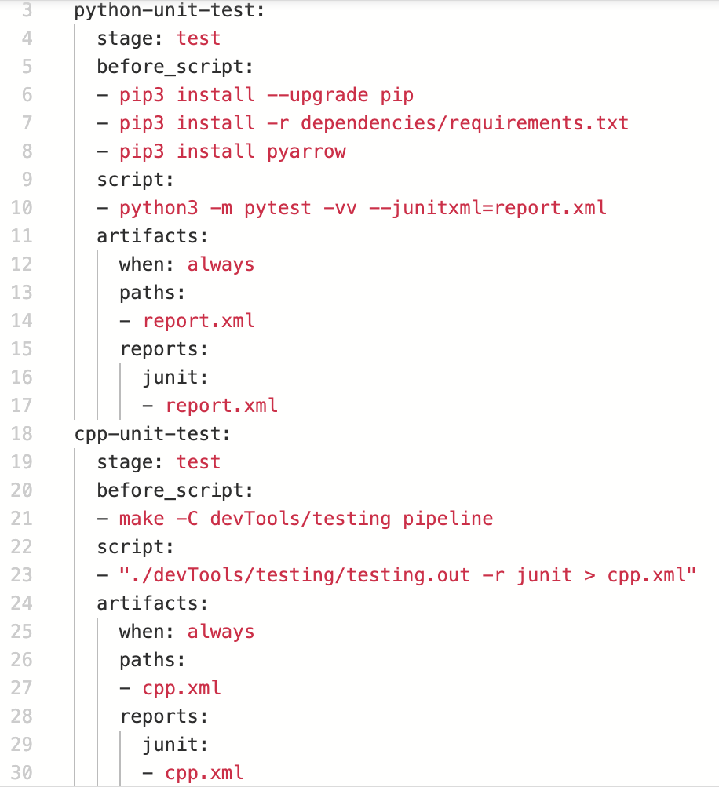
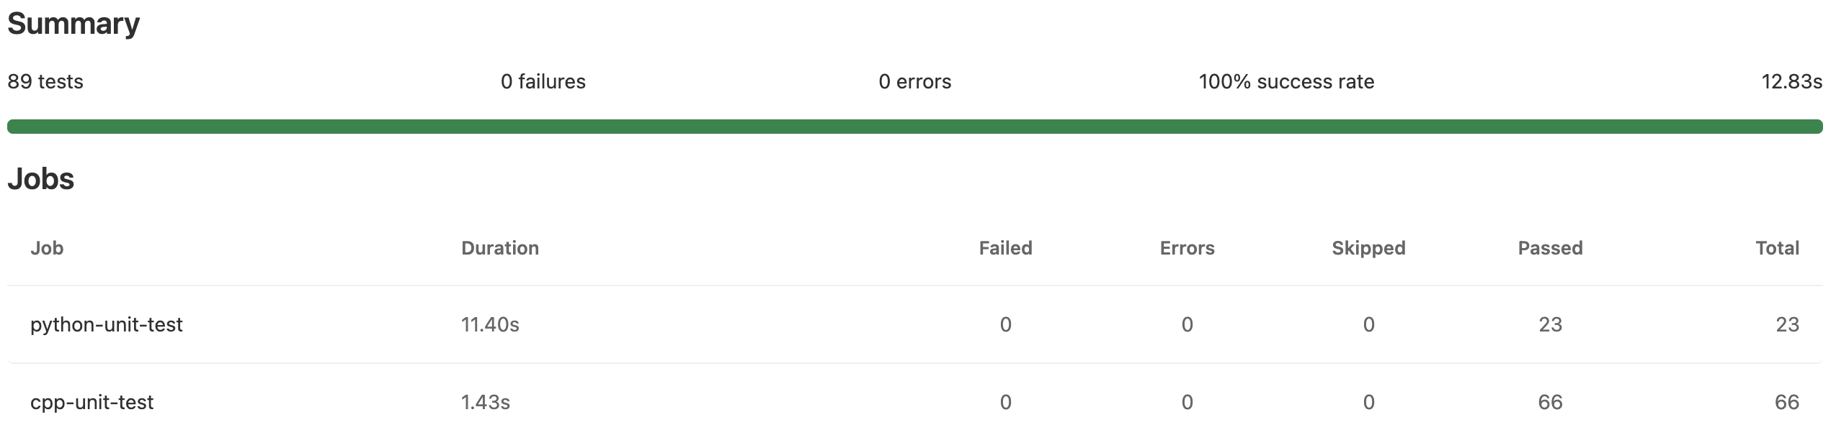
Flight Software Testing Results
Pytest used for Python testing
Catch2 used for C++ testing
All “merge requests” in GitLab trigger the pipeline, compiling and running all tests

Slide 6
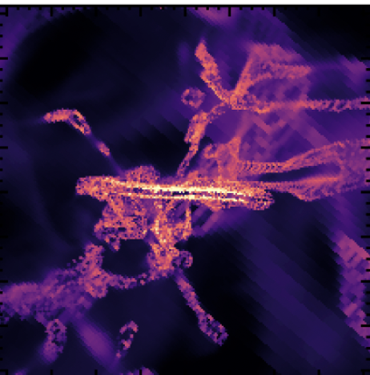
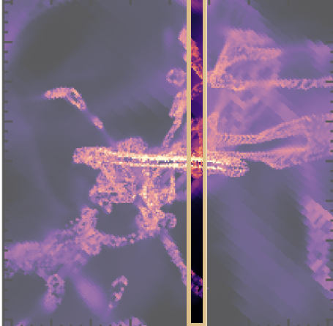
Aspera Observation Overview
Image Source: Lauren Corlies
Event lists are used as input to data reduction pipeline to generate scientific data
X | Y | PHA | TIME
X0 | Y0 | PHA0 | TIME0
X1 | Y1 | PHA1 | TIME1
… | … | … | …
XN | YN | PHAN | TIMEN
Photons are processed through optics and reach the microchannel plate (MCP) detector

Slide 7
Simulator Procedure
Extract data from 3D emission cube data along the instrument field of view whose position and angle is provided by a user
Account for optical “blurring” by putting data through a gaussian filter
Transform emission cube data (surface brightness) into photon counts
Translate spatial and spectral coordinates into x and y values on the detector
Generate an event list in a flexible image transport system (FITS) file

Slide 8
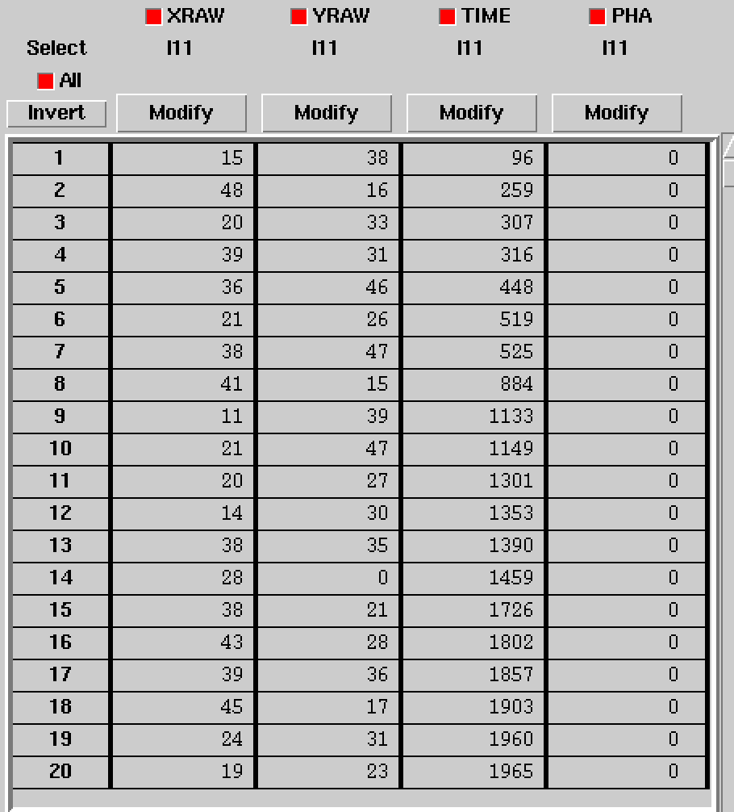
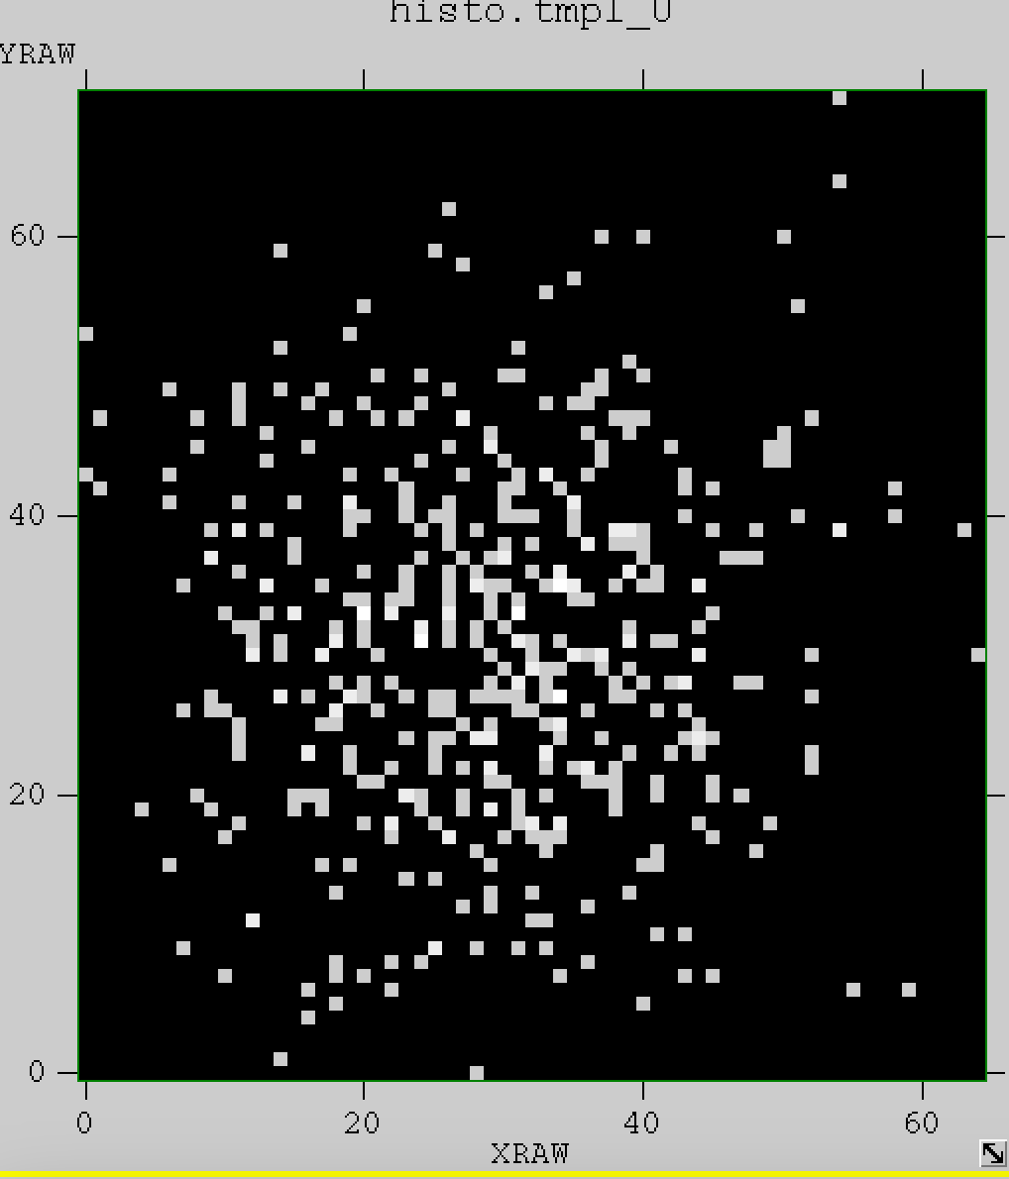
Instrument Simulator Results

Slide 9
Next Steps
Continue writing flight software and corresponding tests, which will be auto-triggered by the pipeline
Use the simulator data to begin construction of the data reduction pipeline
Generate sample files based on given specifications provided by data archive that will allow for storage of data in perpetuity

Slide 10
Acknowledgements
I would like to thank:
My mentor: Carlos Vargas
My supervisors: Sanford Selznick and Miriam Keppler
The Aspera software team
The Arizona Space Grant staff and advisors

Slide 11
Thank you!
Jacob Chambers
University of Arizona
chambersjacobj@gmail.com

